Slide 1
Virtual Mouse with Computer Vision
Tomson George (C0857730)
Praveen Mahaulpatha (C0860583)
R. B. C. M. W. Thulana Vimukthi Abeywardana (C0861333)
Artificial Intelligence and Machine Learning
AML 1214 2 - Python Programming
Simrandeep Kaur
June 28, 2022

Slide 2
Content
Introduction
Problem Specification
Solution Understanding
Use Cases
Project Scope
Technical Specification
Project Architecture
Project Constraints
Project Outcome
Key Deliverables
Key Findings
Conclusion
Future Developments

Slide 3
Introduction

Slide 4

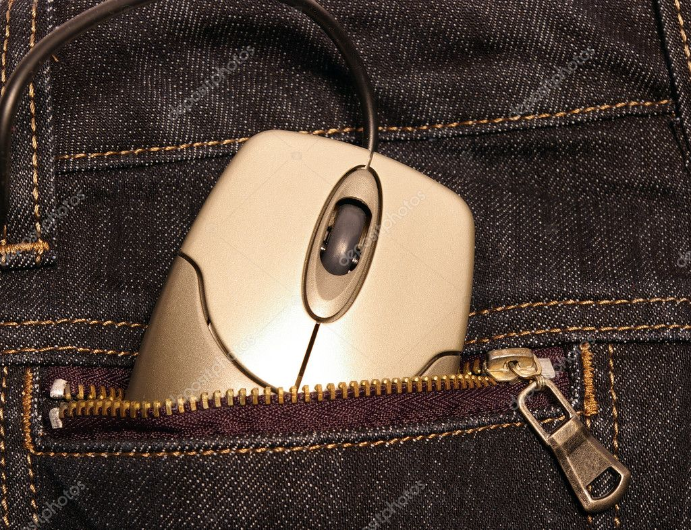
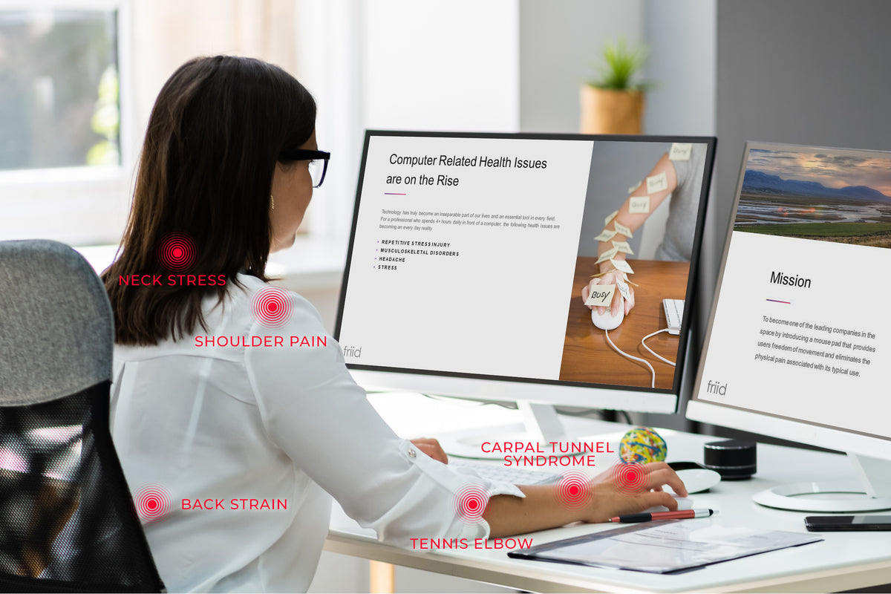
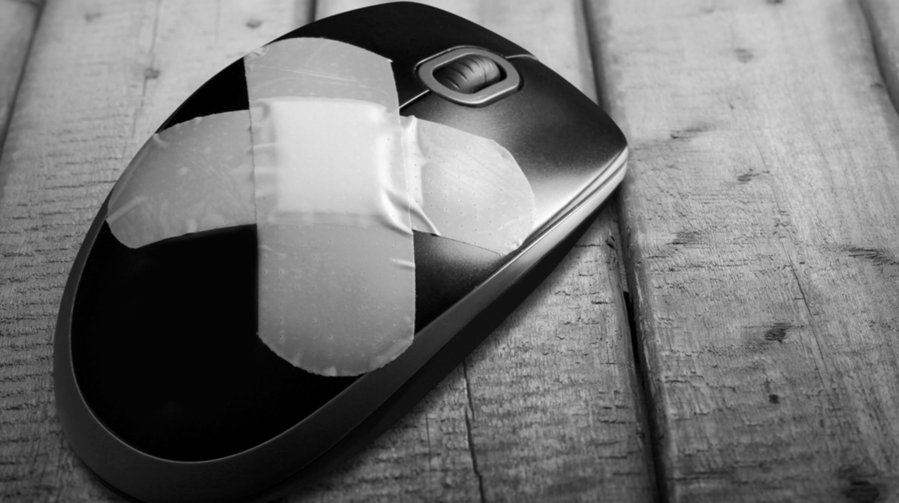
Problem Specification
Restricted movements
Required surface
Prone to Injuries
Prone to Hardware issues
Occupy extra space

Slide 5
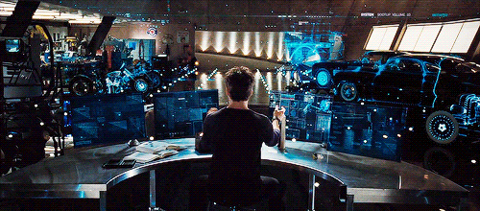
Solution Understanding
Need to include our Demo

Slide 6

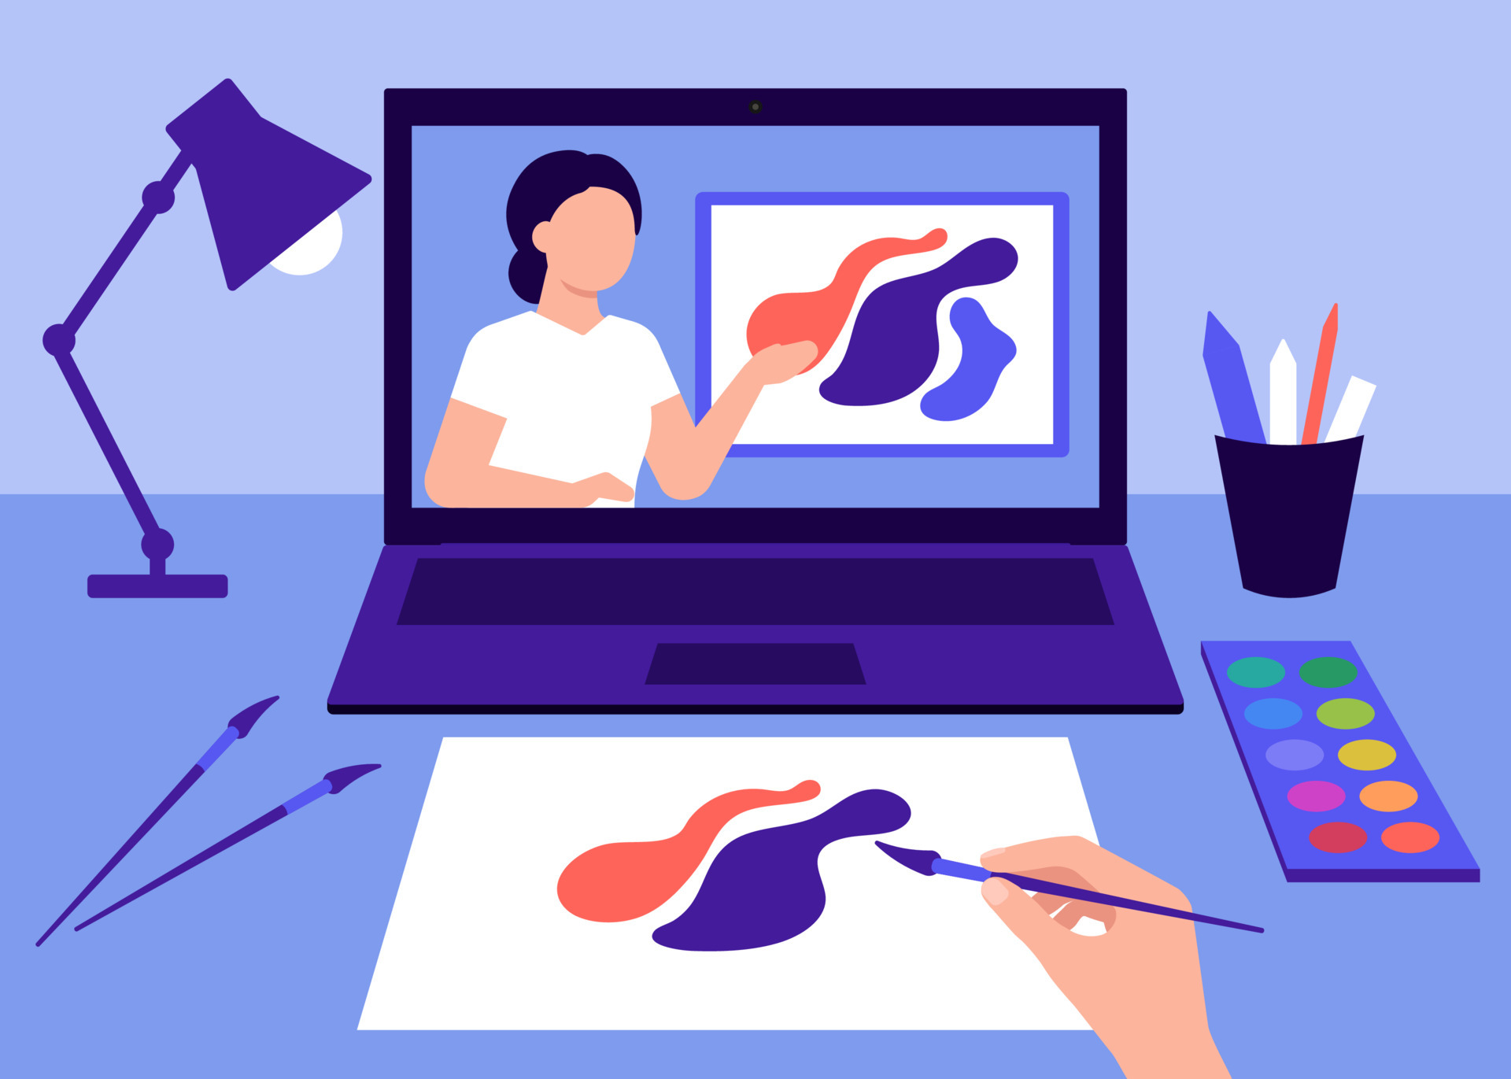

Use Cases
When you want natural and smoother movements
When you are Distant
When your hands are busy

Slide 7
Project Scope

Slide 8
Module Architecture
Initialization
Detect Hand
Find Numbers of Fingers Raised
Find Finger positions
Move
Click
Virtual Mouse

Slide 9
Module 1: Initialization
Passing Default Parameters
Static image mode
Maximum number of hands
Model complexity
Minimum detection confidence
Minimum tracking confidence
Creating a Hands instance with the defined Parameters

Slide 10
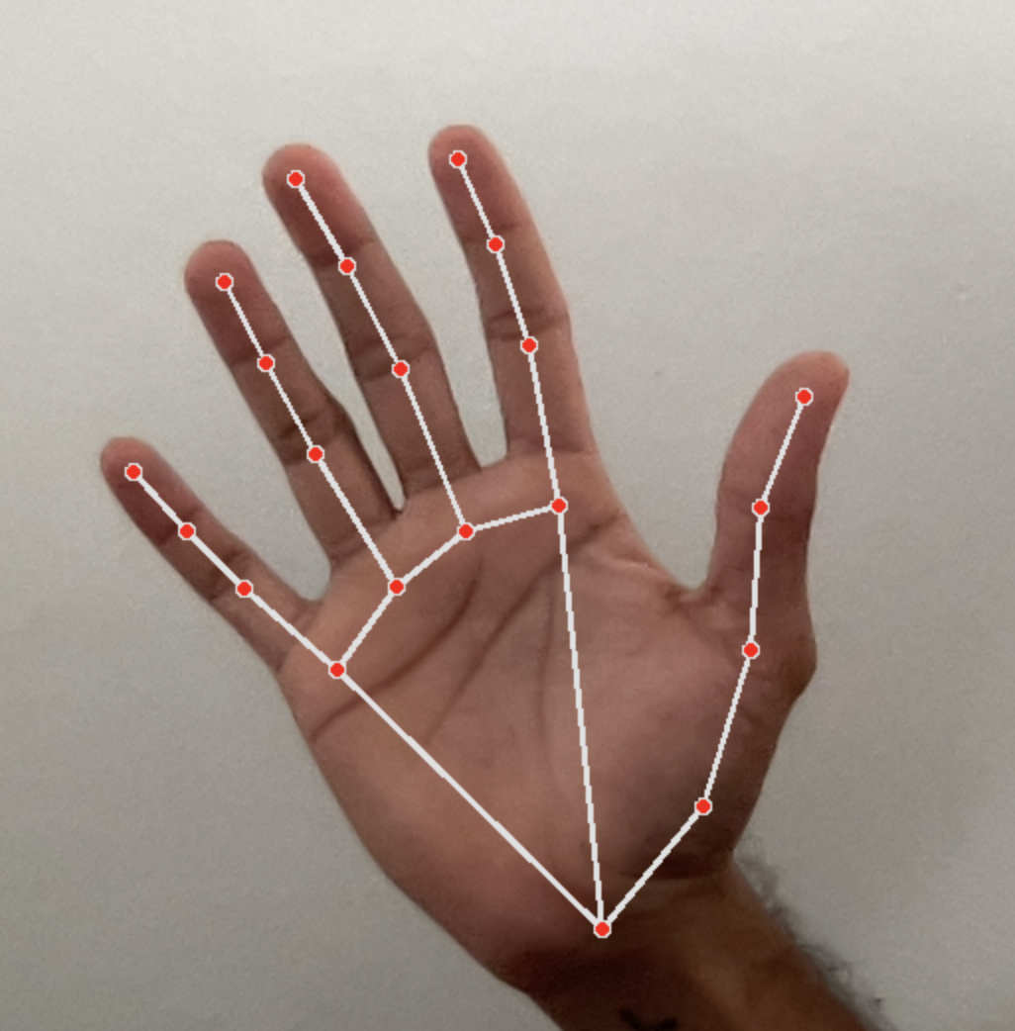
Module 2: Hand Detection
Input Parameters
Webcam image
Draw = True
Convert image to RGB
Drawing connections between hand points
Return Parameters
Connection drawn image

Slide 11
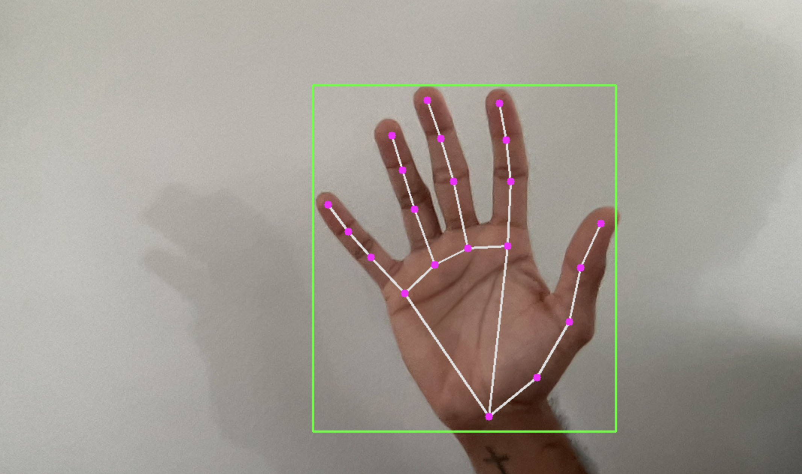
Module 3: Find Positions
Input Parameters
Image
Hand Number = 0
Draw = True
Draw circles on hand points
Draw bounding box for Hand
Return Parameters
Land marks list with ID and Coordinates

Slide 12

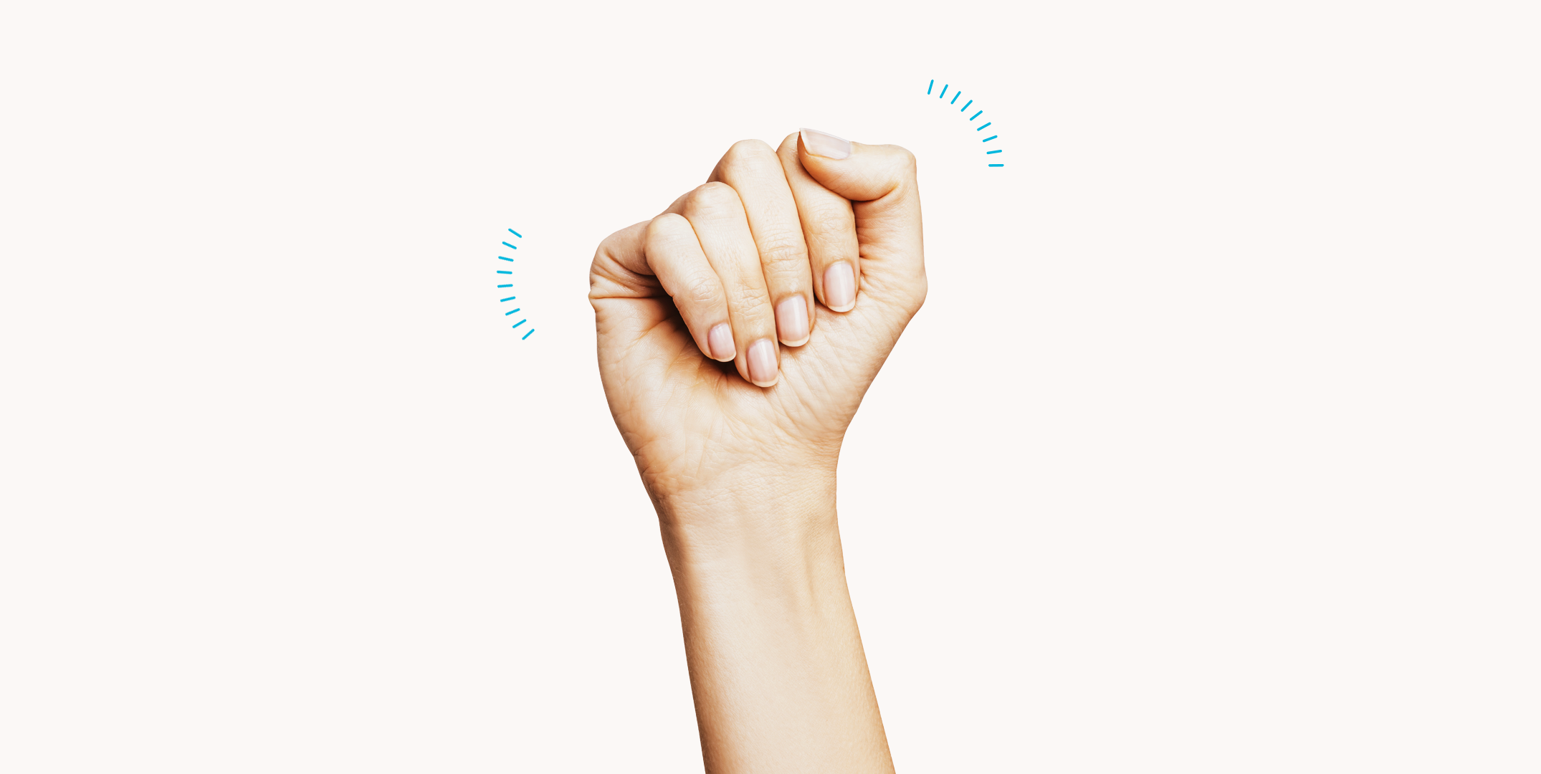
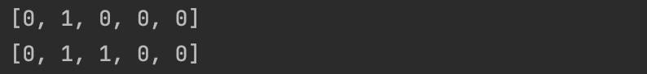
Module 4: Count Raised Fingers
>
x2
x1
No Input Parameters
Check the X coordinates of Thumb
Check the Y coordinates for other 4 points
Return Parameters
List of raised/not raised finger tips
y2
<
y1

Slide 13
Module 5: Move
Drawing bounding box
Convert Coordinates to Ration of Screen
Smoothen the Values of Coordinates
Move mouse using “pyautogui” module’s inbuilt functions
* Need a Demo

Slide 14
Module 6: Click
Check whether both Index and Middle fingers are raised
Check whether the distance between them
If it is less than selected threshold Perform click
* Need a Demo

Slide 15

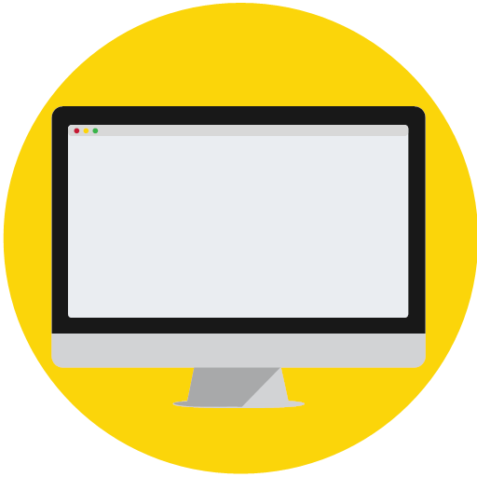


Project Architecture
Modules
Input
Output
Libraries
IDE

Slide 16


Technical Specification
Libraries | IDE | Programming Method | Python Version
cv2 | Pycharm | OOP | 3.8.9
mediapipe
time
math
numpy
pyautogui

Slide 17
Project Challenges
Smoothening Movements of cursor
Clicking on relatively smaller icons

Slide 18
Conclusion

Slide 19
Future Developments
Improved functionality
Double Click
Move through windows
Minimize
Portable executable

Slide 20
Any Questions?

